Slide 1
Top 20 Constellations in the Northern Hemisphere

Slide 2
Circumpolar Constellations
Circumpolar constellations circle around the North Star Polaris.
These constellations are visible all year.

Slide 3
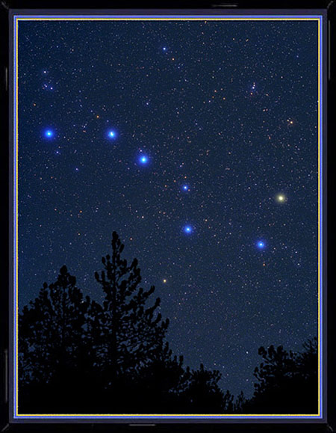
Ursa Major (Big Bear) = Big Dipper

Slide 4
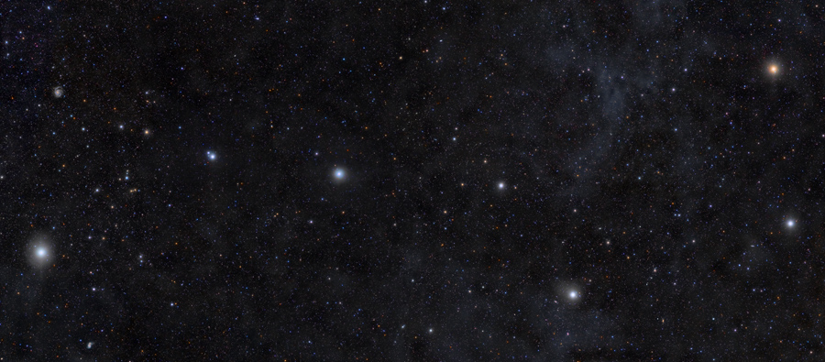

Slide 5
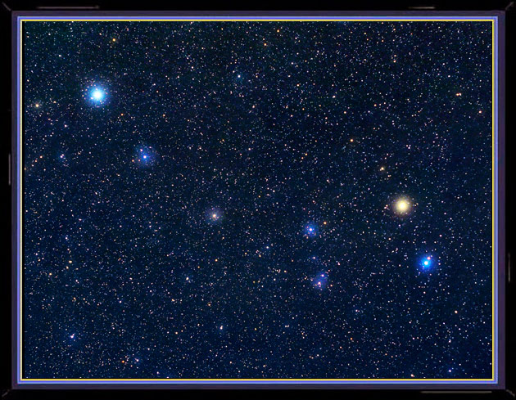
Ursa Minor (Little Bear) Little Dipper

Slide 6
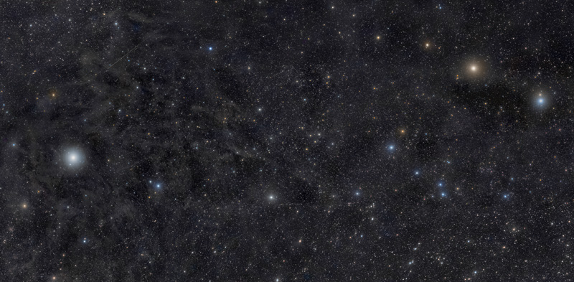

Slide 7
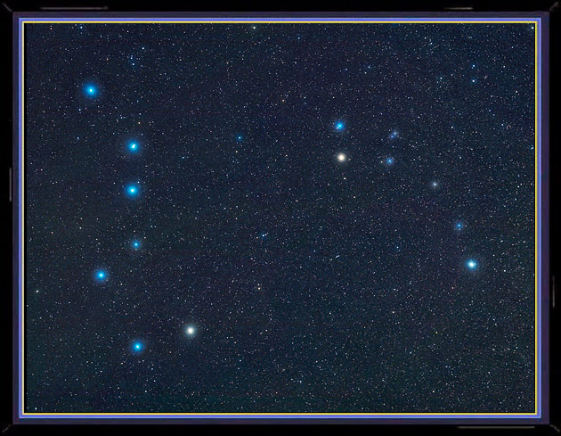

Slide 8
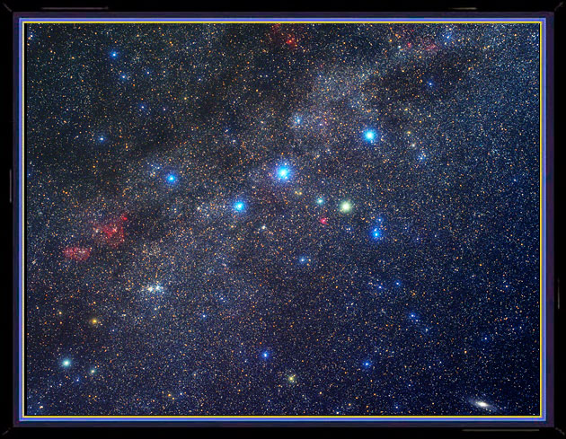
Cassiopeia the Queen

Slide 9
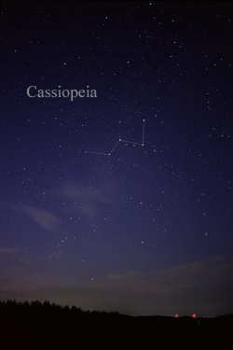

Slide 10
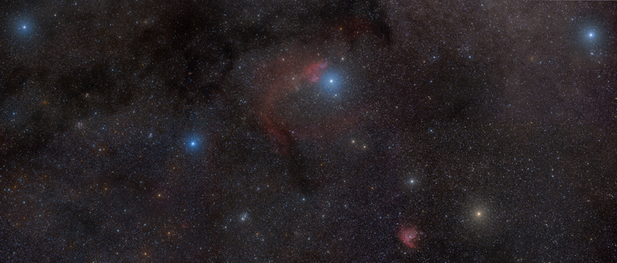

Slide 11
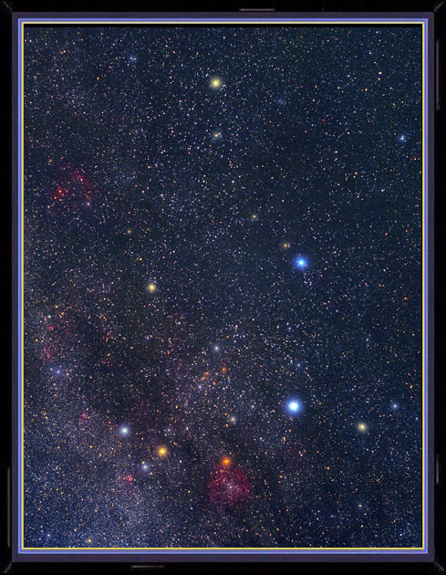
Cepheus the King

Slide 12
Summer Constellations
During the summer months our view of space is toward the center spine of the Milky Way Galaxy. The center core of our galaxy is located between the constellations Scorpio and Sagittarius.

Slide 13
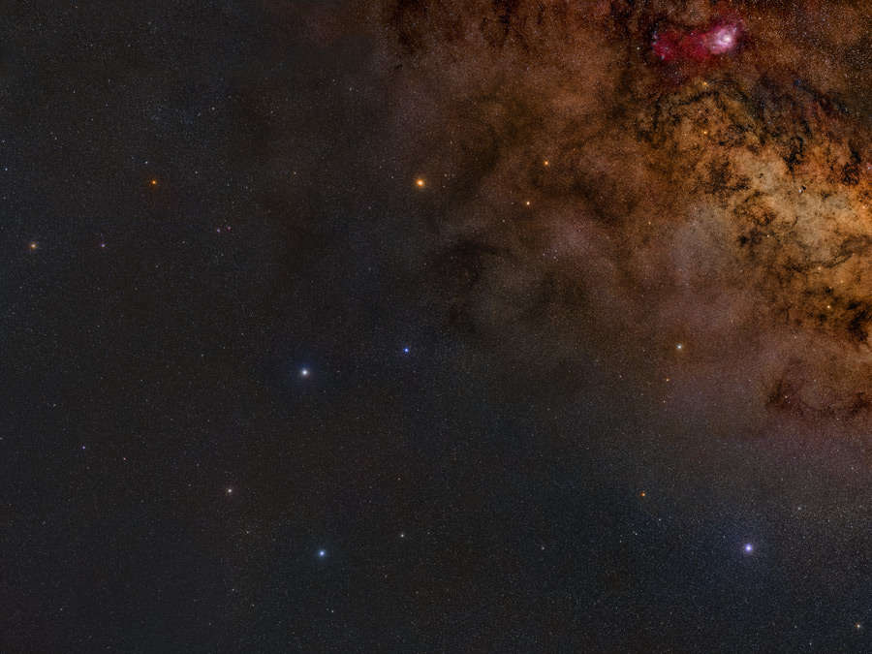
Sagittarius (The Tea Pot)

Slide 14
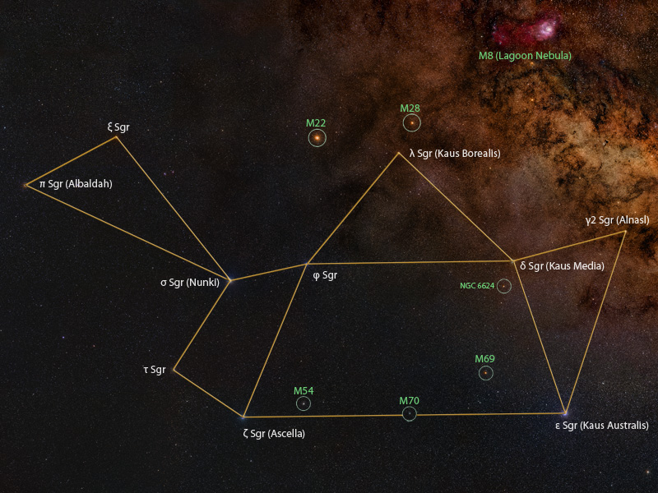

Slide 15
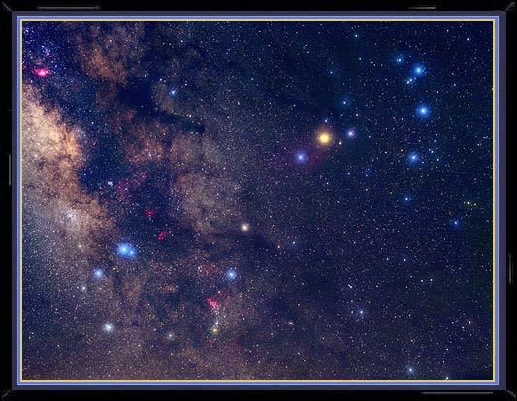
Scorpio and the Super Giant Antares

Slide 16
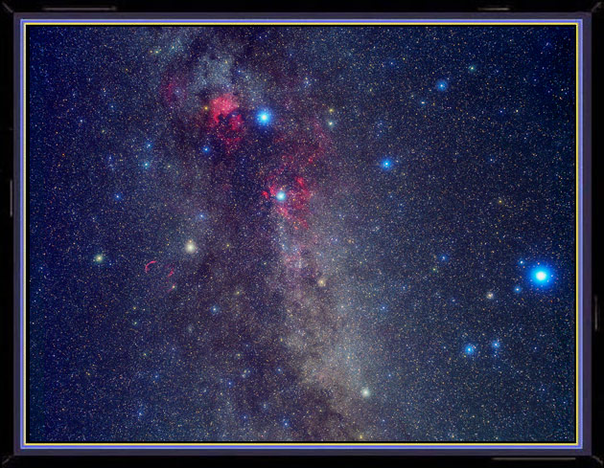
Cygnus (Northern Cross) & Lyra

Slide 17
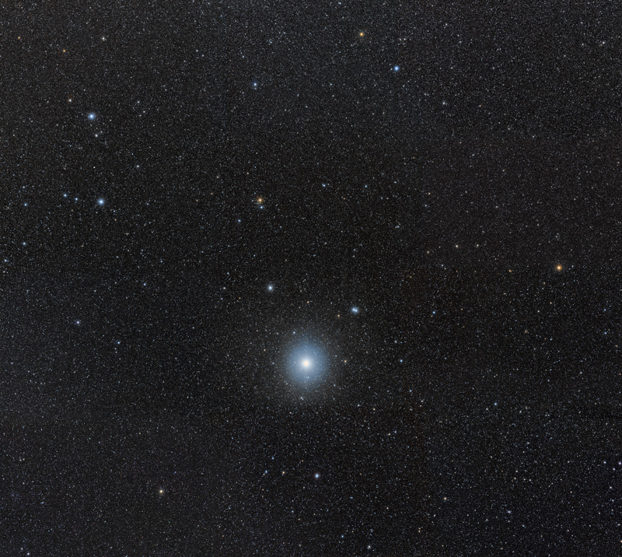
Lyra & the bright star Vega

Slide 18
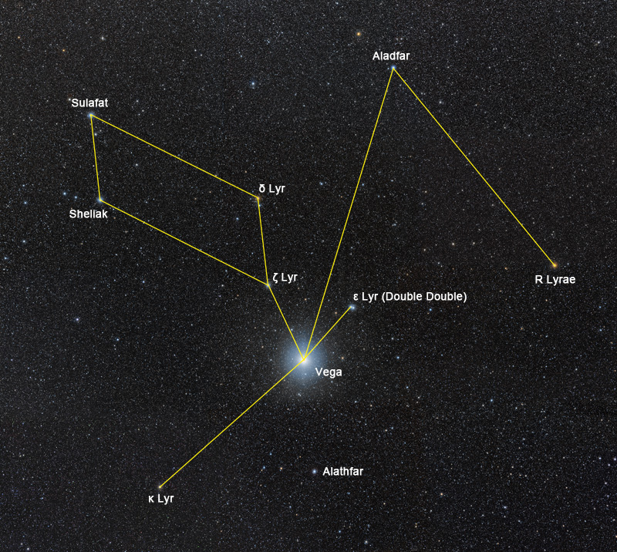

Slide 19
The Autumn Constellations
During the cool Autumn nights our orbital view gives us a look outside of our own Milky Way Galaxy. This brings us a spectacular view of the great Andromeda Galaxy and the square of Pegasus.

Slide 20
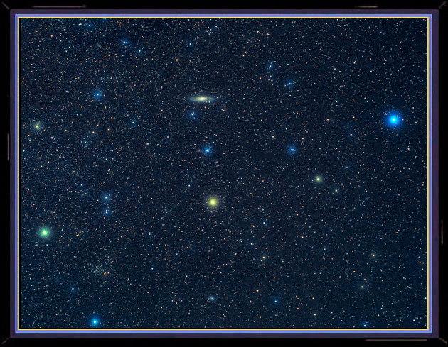
Andromeda with the Galaxy M31

Slide 21
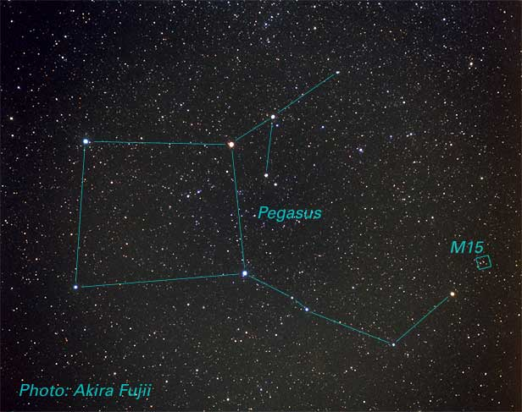

Slide 22
Cassiopeia is circumpolar but highest in the Autumn sky.

Slide 23
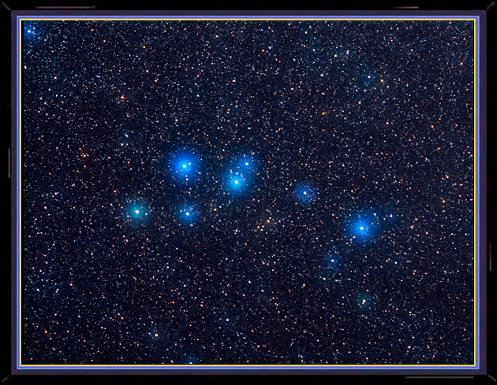
Delphinus the Dolphin

Slide 24
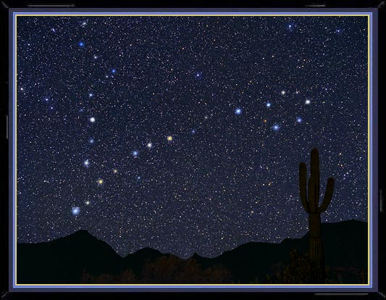
Pisces the Fish

Slide 25
The Winter Sky
The Winter sky brings earth to another view of a spiral arm in our Milky Way Galaxy. The Winter sky is dominated by Orion the hunter with his dog Canis Major. The brightest star in the night sky is Sirius, the dog’s diamond studded collar.

Slide 26
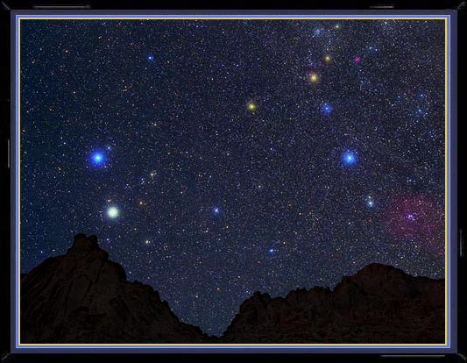
Gemini the Twins

Slide 27
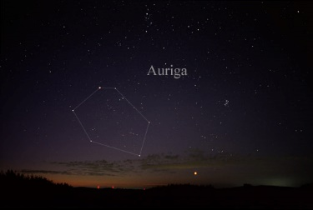

Slide 28
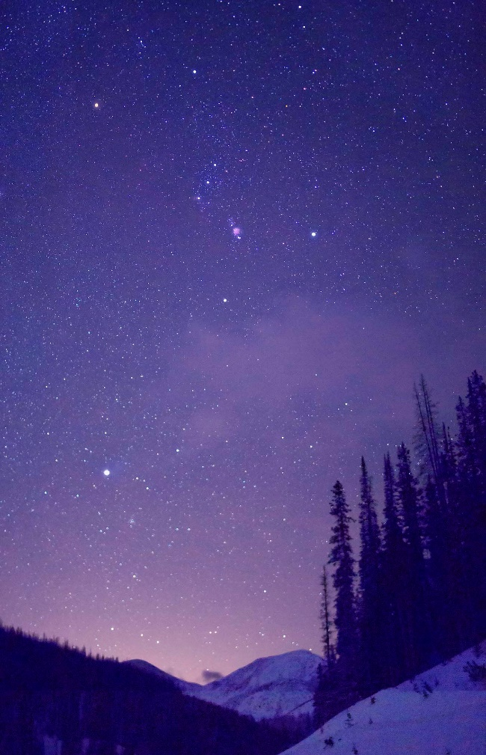
Orion the Hunter with Sirius

Slide 29
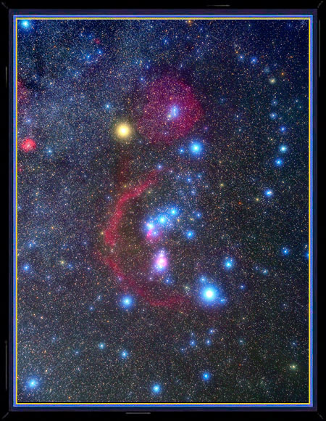

Slide 30
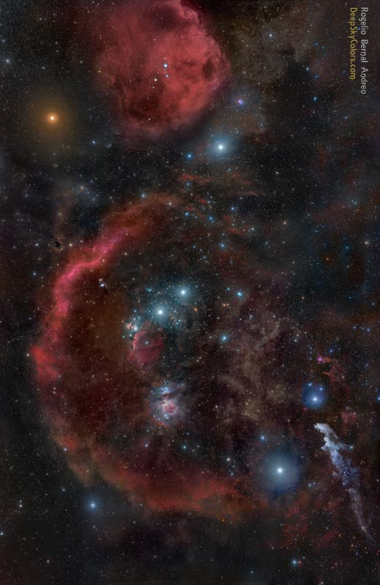

Slide 31
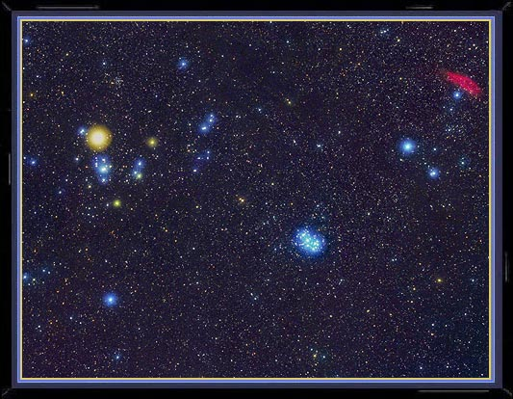
Taurus the Bull & the Pleiades

Slide 32
The Spring Constellations
The view of the spring sky takes us out of the milky way where we can observe many faint galaxy clusters in Virgo and Leo. Because we are not looking in line with the milky way, the spring sky has very few bring stars.

Slide 33
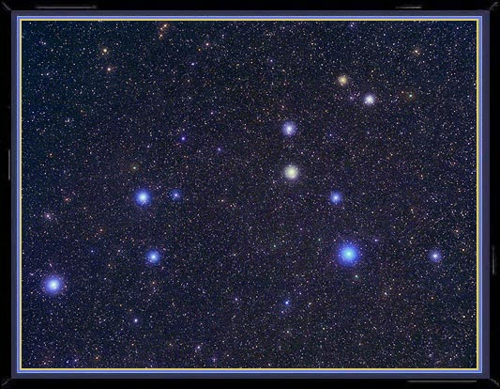
Leo the Lion

Slide 34
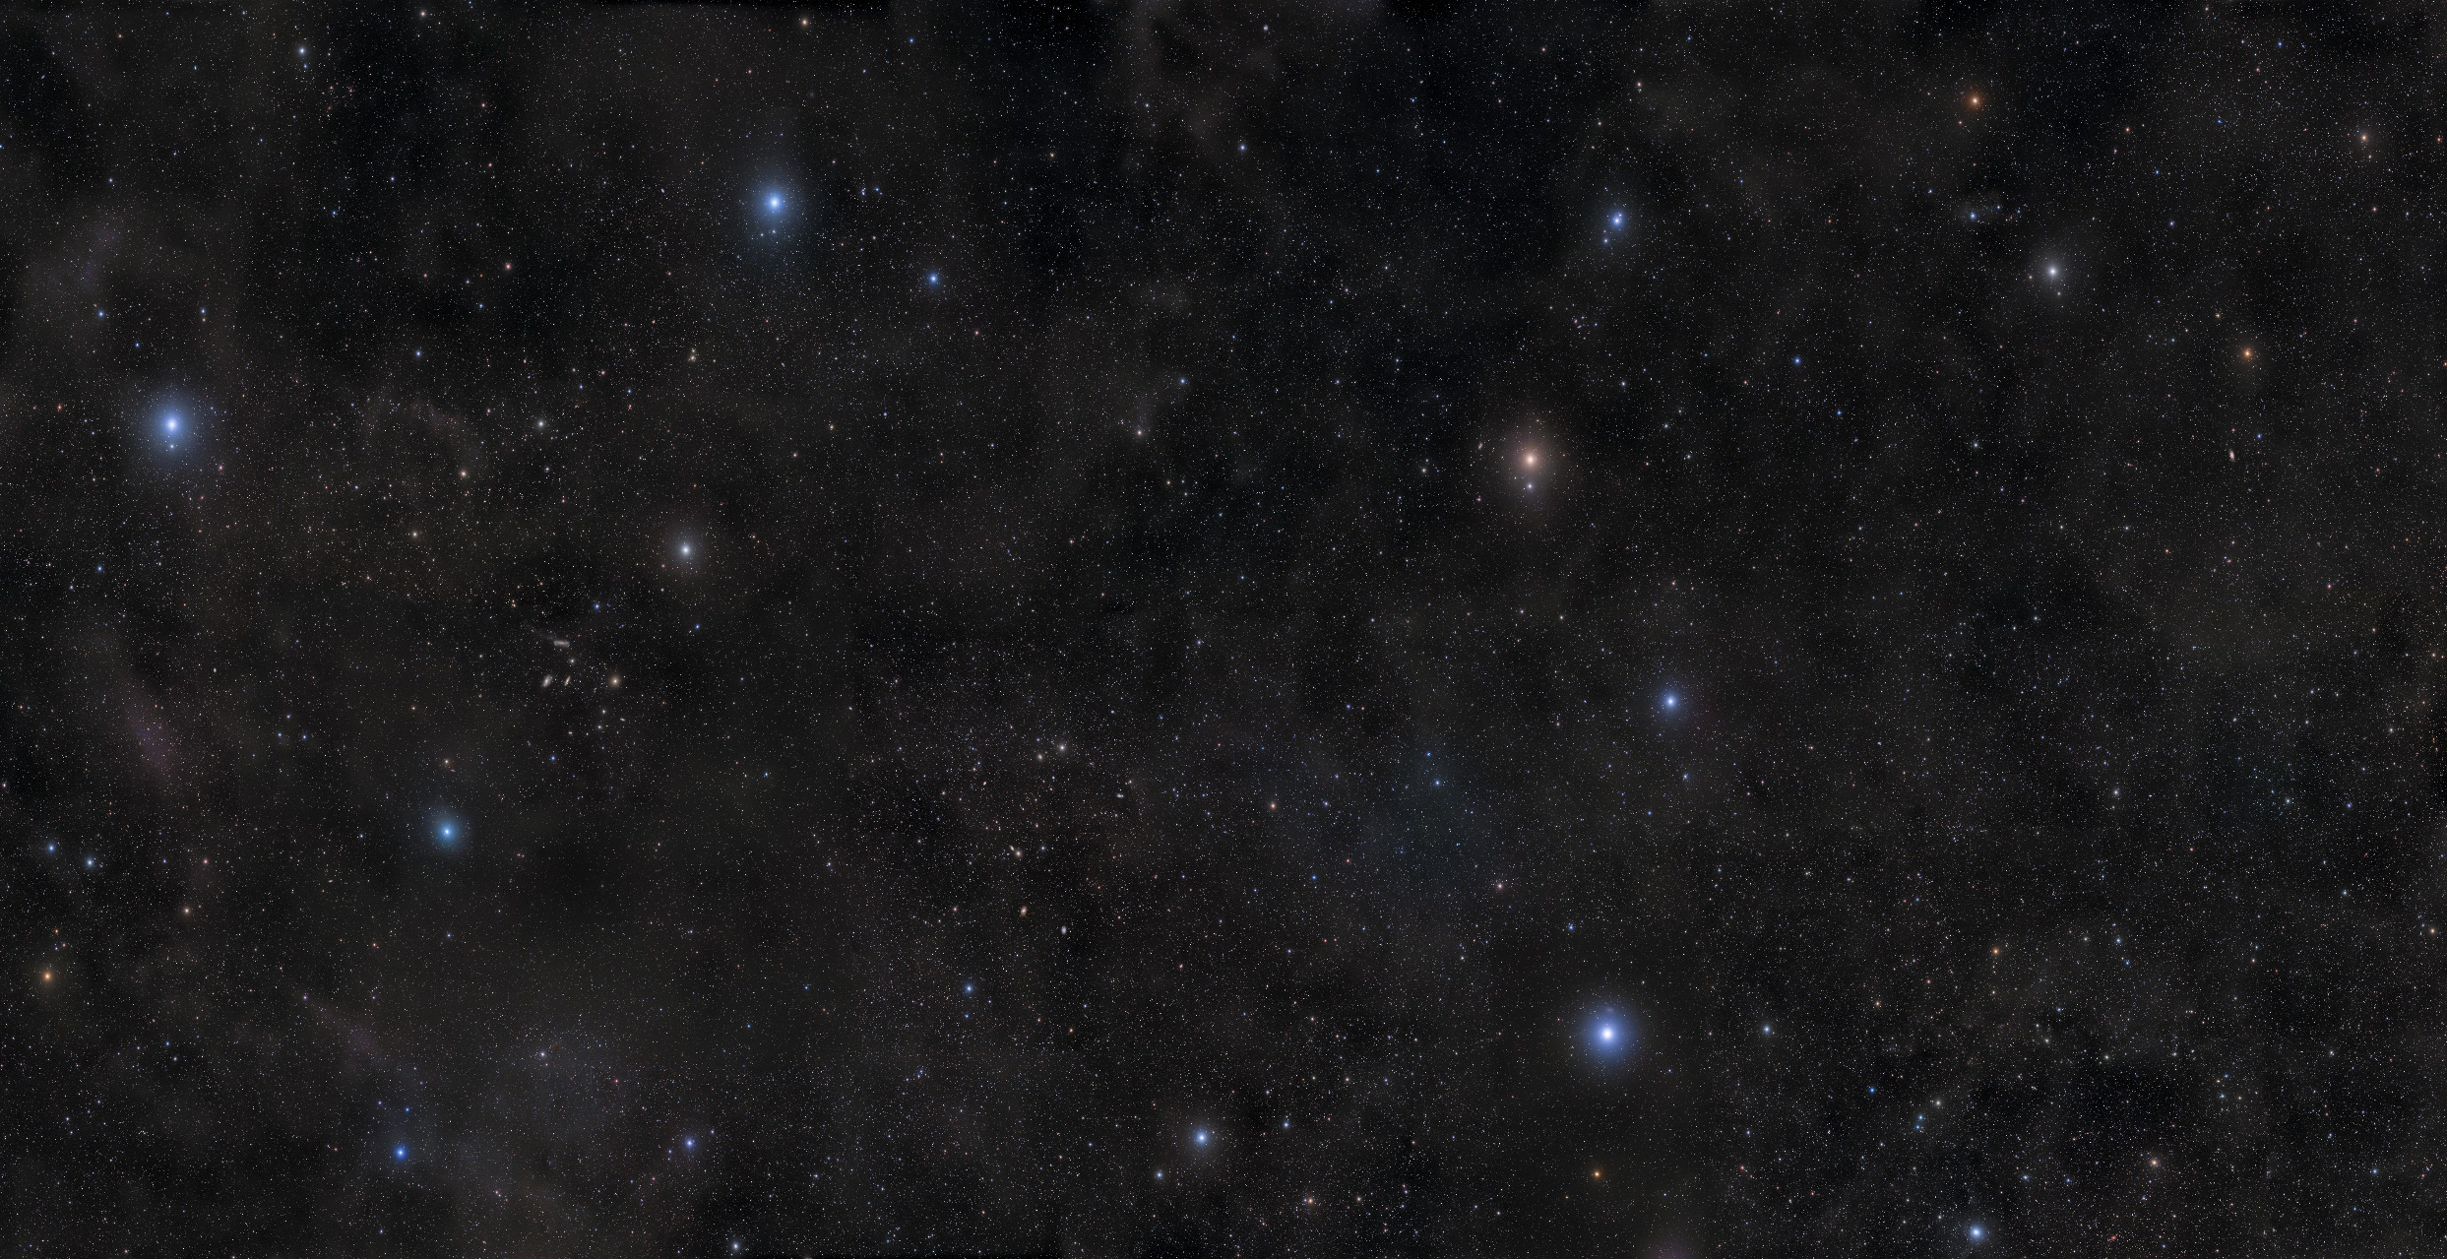

Slide 35
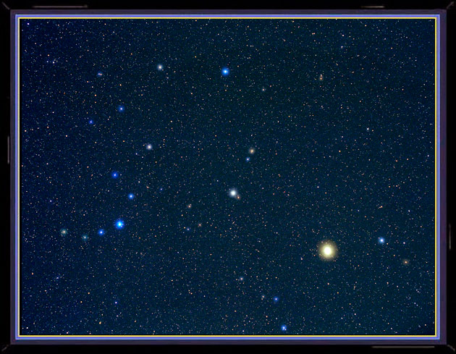
Bootes & Corona Borealis

Slide 36
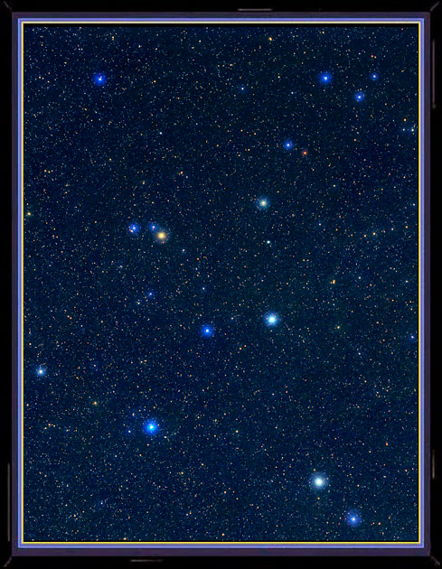
Hercules the strong man

