Slide 1
Stars

Slide 2
Characteristics of Stars
Stars differ in many features:
Color
Temperature
Size
Composition (what it’s made of)
Brightness

Slide 3
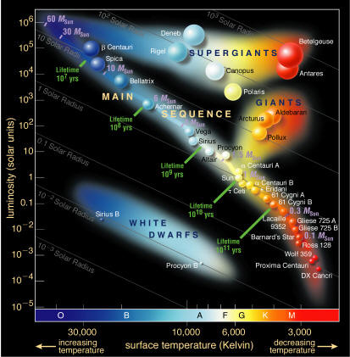
HR Diagram
This diagram is used to compare the temperature and luminosity (brightness) of a star.
In this diagram stars are grouped by color, size, and age.

Slide 4
Size of Stars
Supergiant 100 x as big as the sun
Giant 45 x as big as the sun
Medium-sized as big as the sun
Dwarf smaller than the sun
Neutron star diameter of only 16 km

Slide 5
Size of Stars
Watch this clip.
https://www.youtube.com/watch?v=HEheh1BH34Q

Slide 6
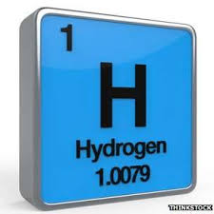
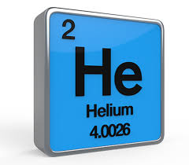
Composition of Stars
To determine the composition of stars, astronomers use a spectrometer
(We will be doing a spectroscopy lab next week to learn how they do this!)
The most common element in stars is hydrogen.
Helium is the second most common element.

Slide 7
Surface Temperature

Slide 8
Brightness of Stars
The brightness of a star depends on:
Temperature (hotter is brighter)
Size (larger is brighter)
Distance (closer is brighter)
This can be changed by intervening matter blocking the light from a star
The apparent magnitude is the brightness of a star as it appears from Earth.
The luminosity is the amount of light the star actually gives off.

Slide 9
Life Cycle of a Star

Slide 10
Star Formation
The gravitational collapse of a Nebula forms a Protostar.
Nebula – large cloud of gas and dust
Protostar – Gases condensing with increasing temperature and pressure to form a spinning disc of matter.

Slide 11
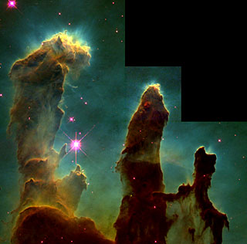
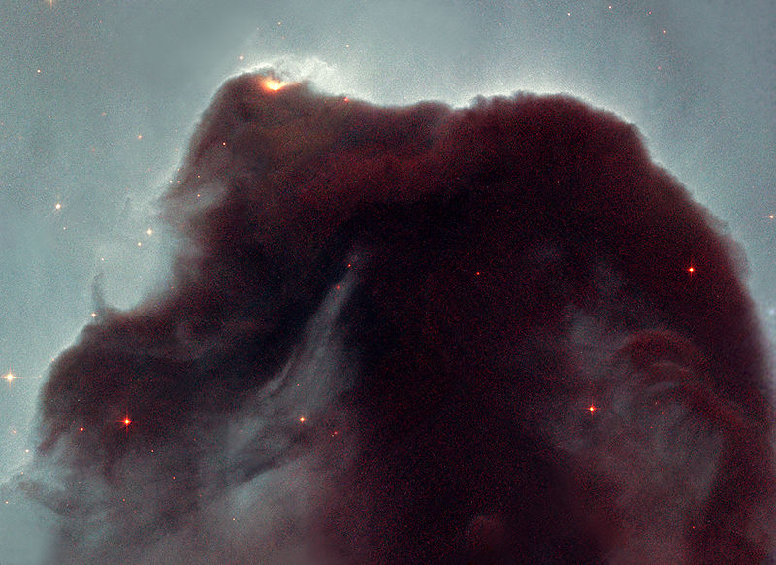
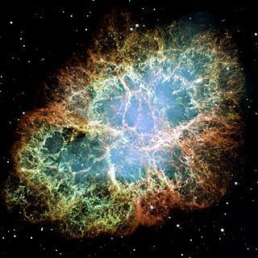
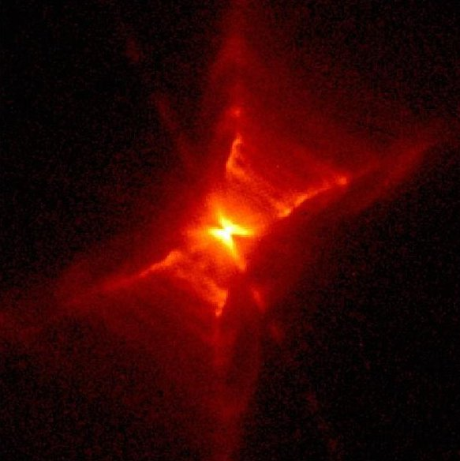
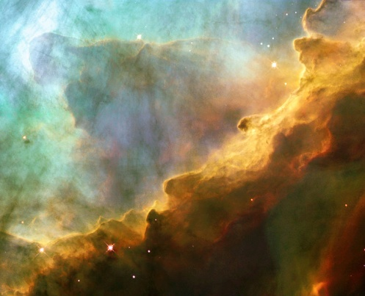
Nebula

Slide 12
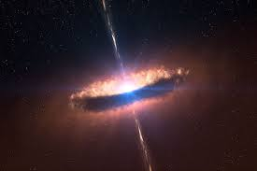
A star is finally born when the temperatures of the protostar become high enough for nuclear fusion to start.

Slide 13
Main-sequence Stars
Second and Longest stage for stars
Star is fusing Hydrogen to form helium
Length of time spent as main-sequence depends on the mass of the star.

Slide 14
Leaving main-sequence
Sun-Like Stars
Massive Stars
These turn into Red Giant Stars
less than 3 times larger than sun
These turn into Red Supergiant Stars
3 or more times larger than sun
Brighter then giant stars, but have relatively cool outer shells
No more hydrogen in outer shell
Start fusing hydrogen in layer around inner shell
Eventually will run out of hydrogen and start fusing helium

Slide 15
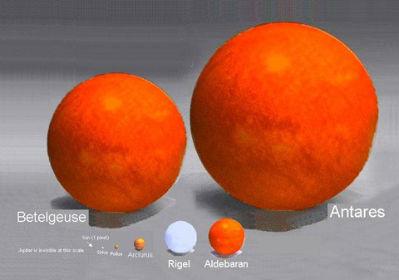
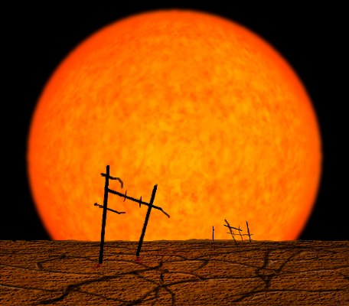
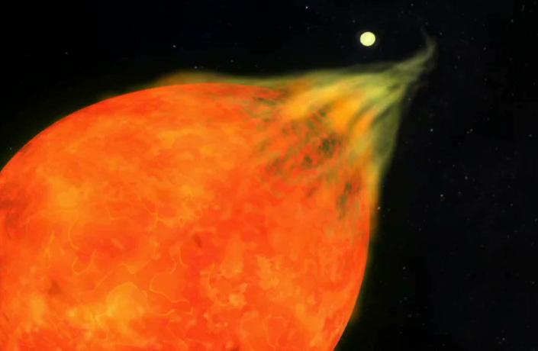
Red Giants and Red Supergiants

Slide 16
Final Stages
Sun-like Stars
Massive Stars
Helium fuses into carbon and oxygen causing easy fuel for fusion to run out
The lower energy causes the gases to expand out into space forming a planetary nebula
These stars become supernova
Star collapses under its enormous mass causing an increase in temperature and pressure enough to start carbon fusion.
Core turns to iron and can no longer fuse causing star to collapse on itself again.
Energy released from the collapse explodes the outer layers of the star

Slide 17
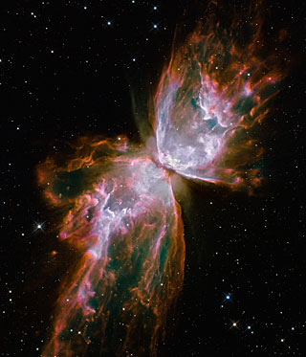
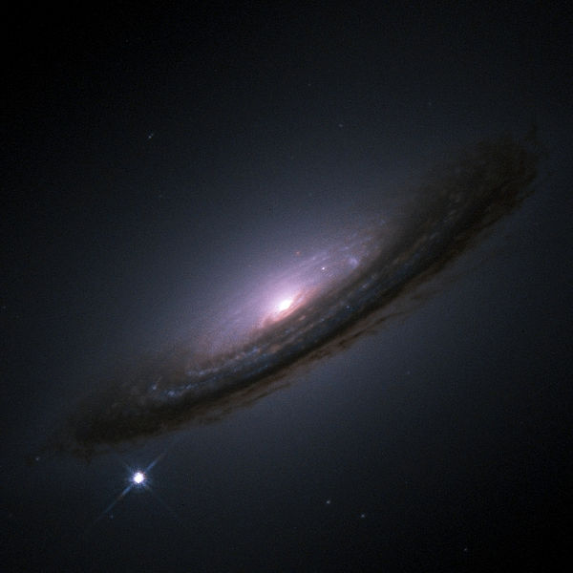
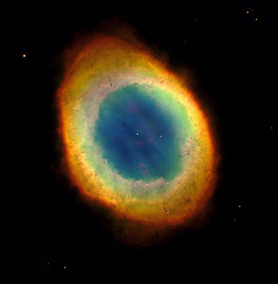
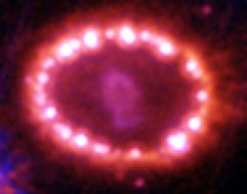

Slide 18
Final Stages Continued
Sun-like Stars
Massive Stars
Gravity causes remaining matter after planetary nebula to collapse on itself.
A White Dwarf forms
Very hot, very dense core of matter
After supernova, core collapses into neutron star
Very small, very dense ball of neutrons
Rotates very quickly

Slide 19
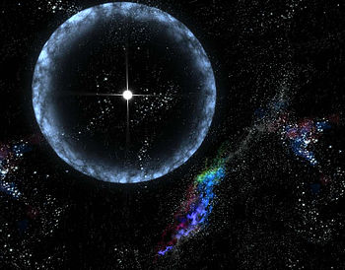
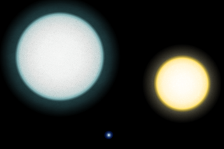
Gases still leaving with neutron star left in the middle
Pegasi A
Sun
Pegasi B (white dwarf)

Slide 20
Massive Stars Final Stages Cont.
Neutron Star
Black Hole
Some neutron stars emit pulses of radio and x-rays
These pulses occur at same rate of rotation as the neutrons star so are very periodic
Such stars are called Pulsars
If the mass after a supernova is too great (greater than 10 times mass of the sun) to compress stably into a neutron star, a black hole can form.
Black holes have high enough gravity that nothing can escape, not even light.

Slide 21
