Slide 1
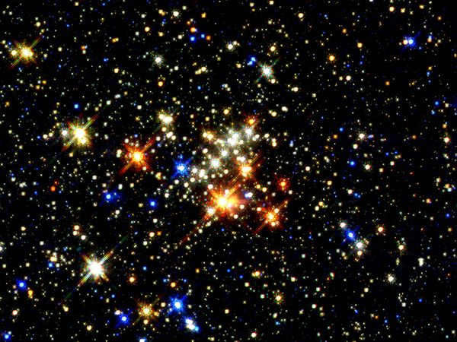
Stars

Slide 2
Clouds of Gas
As the universe continued to expand and cool, atoms formed from the Big Bang coalesced into large clouds of gas
These clouds were the only matter in the universe for millions of years before planets and stars formed
200 million years after the Big Bang, the first stars were formed along with other new elements

Slide 3
Formation of Stars
Stars formed in the giant clouds made mostly of hydrogen, as the cloud began to contract under its own gravity
Stars with denser hydrogen clumps together to form a massive ball of gas
The gas ball contracts under its own gravity creating enormous pressure in the middle
With the increased pressure, temperatures in the center begin to increase
It becomes so hot that electrons are stripped from atoms

Slide 4
Continuing the Formation of Stars
As electrons are stripped away, hydrogen nuclei is left moving faster as the ball of gas continues to contract and increase temperature
When temperature reaches 15 million Kelvin, hydrogen nuclei collides and fuses together (nuclear fusion); releasing a great deal of energy
Energy from nuclear fusion pours out of the center and counteracts the gravity’s inward pull
The ball of gas is becomes stable when the inward pull of gravity balances with the outward pressure from the fusion energy in the core
The energy flows out through the star, when it reaches the surfaces then radiates out into space, and the ball begin to shine

Slide 5
Nuclear Fusion in Stars
In the core of stars, they’re fueled by the energy of nuclear fusion
Depending on the size of the star, different elements are created in the fusion process

Slide 6
The making of elements in a large star

Slide 8
Characteristics of Stars
Size
Mass
Color
Temperature
Brightness

Slide 9
Size of Stars
Biggest Stars:
Super Giants (1000x as big as the sun)
Giant Stars (45x as big as the sun)
Medium Stars (as big as the sun)
Smallest Stars:
White Dwarf (smaller than Earth)
Neutron Stars (diameter of 16 km=10 miles)

Slide 10
Composition of Stars
Spectroscopes are used to determine the composition of stars
Most common elements in stars are Hydrogen and Helium (which element came first?)

Slide 11
Surface Temperature of Stars
Hottest Star Color:
Blue-White
White
Yellow
Coolest Star Color:
Red-Orange
Red

Slide 12
Brightness of Stars
Brightness of a star depends on:
Size (the bigger the brighter)
Surface Temp. (the hotter the brighter)
Distance from Earth (the closer the brighter)
Apparent Magnitude: brightness of a star as it appears from Earth
Absolute Magnitude: amount of light the star actually gives off

Slide 13
H-R Diagram

