Slide 1
Evaluating Evidence of Plate Tectonics
Paper due Friday 01/20

Slide 2
NON-NEGTIONABLES
Must be an individually typed paper
AT LEAST 2 pages
Double Spaced
12 font
Times New Roman
CER Format (Claim, Evidence x3, Reasoning x 3)
AT LEAST 3 cited sources (in text AND on separate reference page)

Slide 3
You’ll score well when you can…
Evaluate evidence of past and current movements of continental and oceanic crust and the theory of plate tectonics to explain the ages of crustal rocks.
AKA:Is there a relationship between plate tectonics and ages of crustal rocks?
Yes or No?
Explain using supported evidence

Slide 4
You’ll be scored on
The Content of the text (Ages of rock and proof of plate tectonics)
The Controlling Idea (make a claim and stick with it; keep it smooth)
Sources (at least 3, cited correctly in and out of text)
Explaining your evidence (back up each one of your pieces of evidence with reasoning for why it supports your claim)

Slide 5
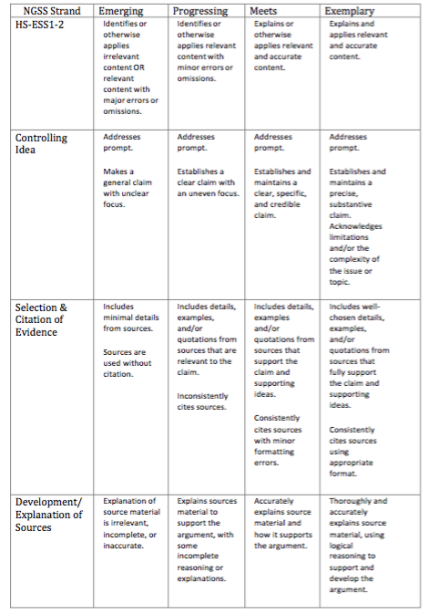

Slide 6
How do you do that?
You need to be able to identify:
crustal materials of different ages arranged on Earth’s surface in a pattern that can be attributed to plate tectonic activity
formation of new rocks from magma rising where plates are moving apart.

Slide 7
What does that mean?
Identify and describe the following:
Ages and locations of continental rocks
Ages and locations of rocks found on opposite sides of mid-ocean ridges
The type and location of plate boundaries (HINT: Convergent, Divergent and Transform/Strike-Slip)
Type, age and location of rocks along plate boundaries

Slide 8
ALSO
Explain how radioactive decay is use to determine the age of rocks

Slide 9
Is your research worth it?
Your evidence will help assess and evaluate the validity of the given evidence.
You need to be able to evaluate the reliability, strengths, weaknesses of the given evidence along with its ability to support logical and reasonable arguments about the motion of crustal plates.

Slide 10
Tie it all together
Describe the relationship between the motion of continental plates and the patterns in the ages of crustal rocks, including:
Mid-ocean ridges, material from Earth’s interior must be emerging and forming new rocks with youngest ages
Continental centers will have oldest rocks because new crust is added to the edge of continents where plates converge, causing subduction zones
Oldest crustal rocks are found on the continents because oceanic crust is constantly being destroyed where plates converge and cause subduction zones

