Slide 1
Continental Drift to Plate Tectonics

Slide 2
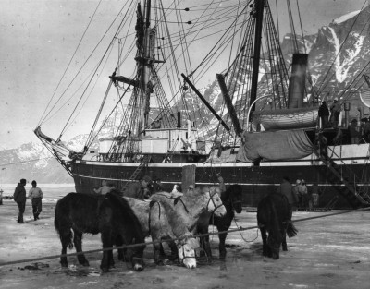
Alfred Wegener’s Early Evidence

Slide 3
Wegener’s Evidence
1. The Puzzle like fit of the continents.
2. Ancient glacier tracks (glacier striations).
3. Matching Geologic features on different continents.
4. Matching fossils on different continents (paleontology).

Slide 4
For centuries people noticed the puzzle like fit of the continents

Slide 5
Wegener’s Pangaea

Slide 6
Ancient Glacier lines match up when the continents are united.

Slide 8
Geologic features match on different continents when united.

Slide 10
Extinct fossils on different continents

Slide 12
Wegener’s Hypothesis
In 1928 Wegener proposed his hypothesis and supporting evidence to a skeptical scientific community.
Wegener’s ideas were overwhelming rejected and he was ridiculed.
PROBLEM: What force was strong enough to push the continents through the solid bedrock or the ocean floor?

Slide 13
Wegener dies in 1930 along with his ideas about continents drifting.

Slide 14
What do these scientist have in common?
Alfred Wegener
Galileo Galilee
Nicholas Copernicus
Charles Darwin

Slide 15
All proposed a radical hypotheses that went against the grain of conventional teachings.
Their ideas were originally rejected because they could not explain the mechanism or reason supporting their hypothesis.

Slide 16
WWII & the invention of Sonar

Slide 17
Mapping the Ocean Floor

Slide 18
1950’s-60’s New Evidence for Continental Drift: Mid Atlantic Ridge

Slide 19
Concept of Sea Floor Spreading

Slide 20
Evidence for Sea Floor Spreading
Youngest rock are found near the Mid Ocean Ridge, Oldest rocks are found near the continents.
Pillow Lava found in the rift of the Mid Atlantic Ridge
Magnetic Reversals: A mirror image recorded like zebra stripes on both sides of the Mid Atlantic Ridge.
Satellite measurements show that the width of the Atlantic Ocean is increasing by 2 to 3 inches per year.

Slide 21
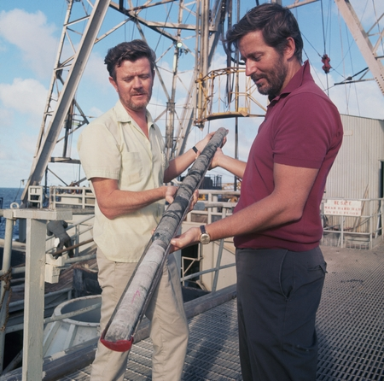
Glomar Challenger

Slide 22
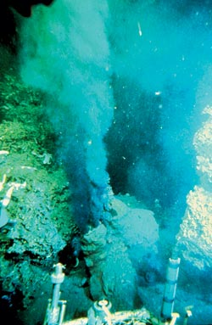
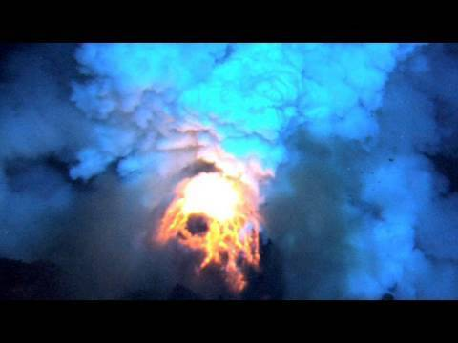
Alvin submersible

Slide 23
Sea Floor Spreading & Magnetic Reversals

Slide 25
Mirror Image of magnetic Reversals

Slide 26
Satellite Measurements show the continents are moving

Slide 27
Plate Tectonics says earth’s crust is divided into sections or plates.

Slide 28
Three types of plate boundaries
Transform Boundary: A lateral side by side sliding of the plates = earth quake zone. Example, San Andreas Fault
Divergent Boundary: Plates moving apart. Sea floor spreading in the Mid Atlantic Ridge, East African Rift, Iceland!
Converging Boundary: Three types of plate collisions.
1. Ocean + Continent = Trench & volcanic Mt. Range.
2. Ocean + Ocean = Deep trench & Volcanic Islands.
3. Continent + Continent = Large mountain range.

Slide 29
Plate Boundaries

Slide 30
Transform Boundary: San Andreas Fault

Slide 31
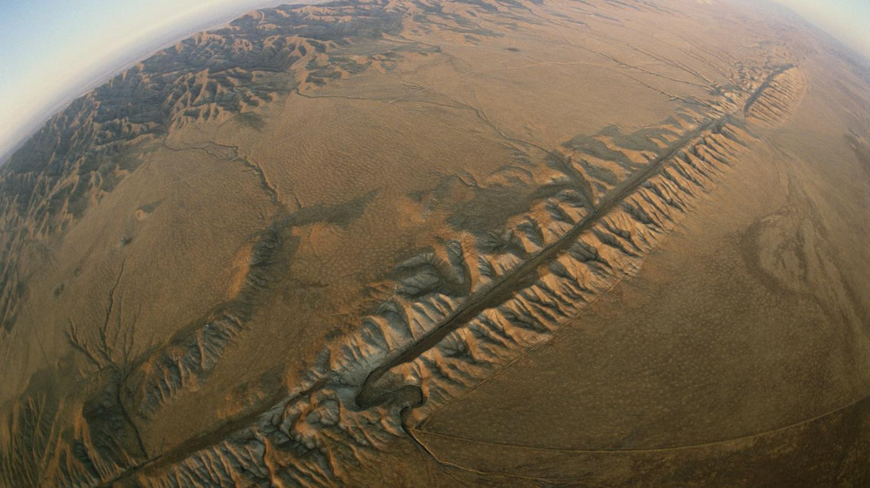
San Andreas Fault

Slide 32
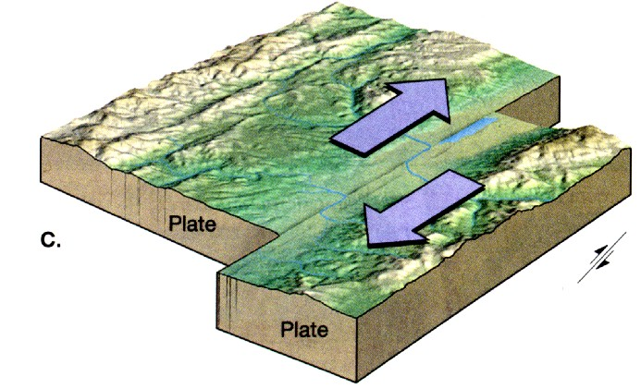

Slide 33
Divergent Plate Boundaries

Slide 34
Iceland is on the Mid Atlantic Ridge

Slide 35
Iceland’s Wall of Lava

Slide 36
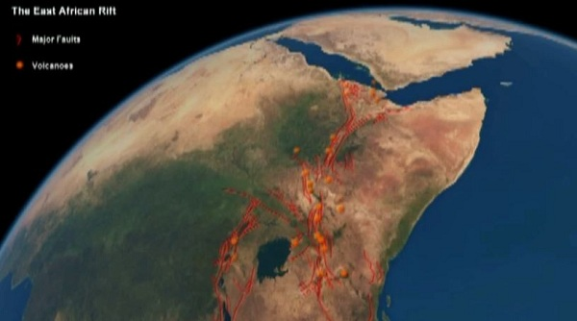
East African Rift & Red Sea

Slide 37
Volcano in East African Rift

Slide 38
3 types of converging boundaries

Slide 39
Convergent Plates: Ocean + Continent

Slide 40
#1Convergence: Cont. + Ocean crust
The dense ocean crust is shoved below the lighter continental crust. This creates a deep ocean trench (subduction zone) and a volcanic mountain range on land.
Examples: Cascade Mountain Range & The Andes of South America.

Slide 41
Plate Boundaries

Slide 42
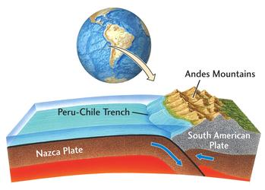
Peru - Chile Trench & the Andes

Slide 43
#2 Convergence: Ocean + Ocean crust
The dense ocean crust is subducted down into a deep ocean trench and creates a volcanic Island arc.
Examples: Mariana’s trench with Japan, Indonesia & the Philippine plate.

Slide 44
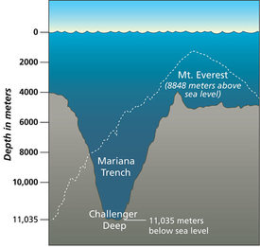
Ocean + Ocean Convergence

Slide 45
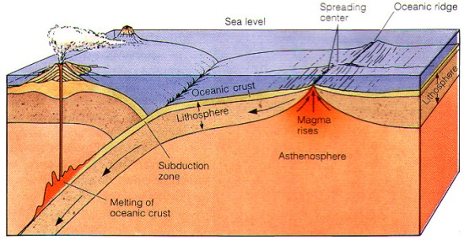
Japan & the Mariana’s Trench

Slide 47
Convergence Continent + Continent
The lighter continental crust collide forming a large mountain range.
The collision with India & Asia created the Himalayan Mountains.

Slide 48
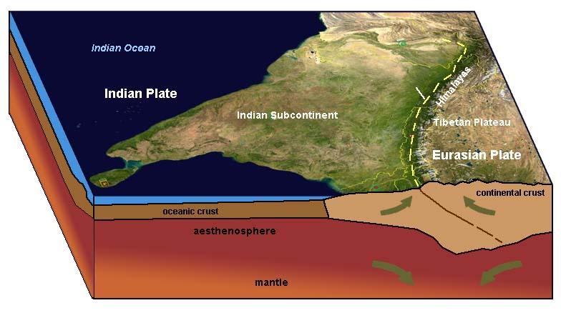
Continental Collision

Slide 49
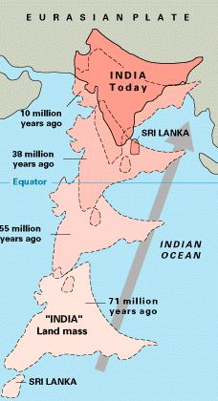

Slide 50
Driving force in Plate Tectonics: Earth’s internal heat = Convection Zones

Slide 51
Slab Pull adds to the plate motion

Slide 52
The Ring of Fire

Slide 53
Distribution of Earth Quakes

Slide 54
Age of Ocean Crust

Slide 55
What about Hawaii in the middle of the Pacific Plate?

Slide 56
Fixed Hot Spot burns a hole in the Pacific Plate

Slide 57
The Hawaiian Chain

Slide 58
