Slide 1
Big Bang Practice and Reflections
How to Improve your Grade on the Big Bang Paper

Slide 2
Controlling Idea Practice
What does a good thesis look like?

Slide 3
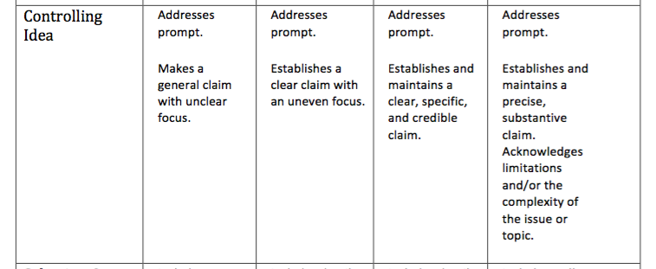
Controlling Idea

Slide 4
Example 1
“Imagine a universe where there was no planets no life no nothing i am going to tell you about how it came to be what it is now from what it was before. The big bang is well it started when a thing that was smaller than an atom that was really hot and exploded and a huge chain of reactions that make our universe the way it is now.mr.Edwin hubble discovered that all the distant galaxies were moving away from us.and within a second the universe cooled down and it was 100 billion keven.”
Mrs. Morel’s Score: 1

Slide 5
Example 2
“Do you know how the universe you live on was created? Astronomical physicists’ have found a theory on how this universe was created, called The Big Bang. This is a widely accepted theory among scientists. Hubble’s data allowed scientists to measure how fast the universe was expanding and with that, they could trace back to when the universe was smaller than an atom. They could also calculate how much smaller the universe was a long time ago with Hubble’s data. Here are some points of evidence that support the Big Bang.”
Mrs. Morel’s Score: 2

Slide 6
Example 3
“The Big Bang created the whole universe 13.7 billion years ago. It was a theory created to better understand where and how the universe was made. It started out as nearly nothing at all then expanded into the many cosmos we know to exist today. We discovered The Big Bang using many theories that scientists have created to better understand our history. Some theories include: cosmic radiation, redshift and blueshift and soundwaves.”
Mrs. Morel’s Score: 3

Slide 7
Example 4
“Imagine something smaller than than an atom exploding to become something capable of creating and running an entire universe. Do you think that is possible? According to scientists it is. Our Universe would never be the way it is today or even be a thing without the help of a tiny object, an object smaller than an atom, this theory is also know as this Big Bang. The Big Bang is a theory stating that the universe was created over a billion years ago from an explosion with infinite energy density. The hardest thing for scientists and average people to grasp is how something so important was made out of nothing. Some of the most important scientist to this theory include Arno Penzias, Robert Wilson Isaac Newton, Sir William Huggins and many more. Many believe this theory, however many also do not. Astronomical evidence, light spectra, motion of distant galaxies, and composition of matter all support the theory of the Big Bang and all help with the understanding of it.”
Mrs. Morel’s Score: 4

Slide 8
Selection and Citation of Evidence Practice
What is an in-text Citation?

Slide 9
Selection and Citation of Evidence

Slide 10
Example 1
“Edwin Hubble discovered in 1925 that there is more to the universe than just our milky way and there are millions of stars very far away. In 1929, Hubble then discovered that light coming from galaxies was more to the red end of the spectrum.”
No Bibliography at End
Mrs. Morel’s Score: 1

Slide 11
Example 2
“Just as “What Is the Evidence for the Big Bang” said, “He realized that most of them were moving away from us.” (Cain, What Is the Evidence for the Big Bang)”
Bibliography at End
Mrs. Morel’s Score: 3

Slide 12
Example 3
“In 1964, two men, named Robert Wilson and Arno Penzias, discovered the existence of cosmic background radiation. The men were asked to try to help figure out what was causing an annoying hiss in early calls relayed by satellites (“Evidence for the Big Bang Theory”, 00:17).”
Bibliography at End
Mrs. Morel’s Score: 4

Slide 13
Example 4
“This point started “ with a hot dense point smaller than an atom...causing the expansion of the universe…” (Big Bang notes, slide 1)”
No Bibliography at end
Mrs. Morel’s Score: 2

Slide 14
Development of Sources
How does your evidence support your caim?

Slide 15
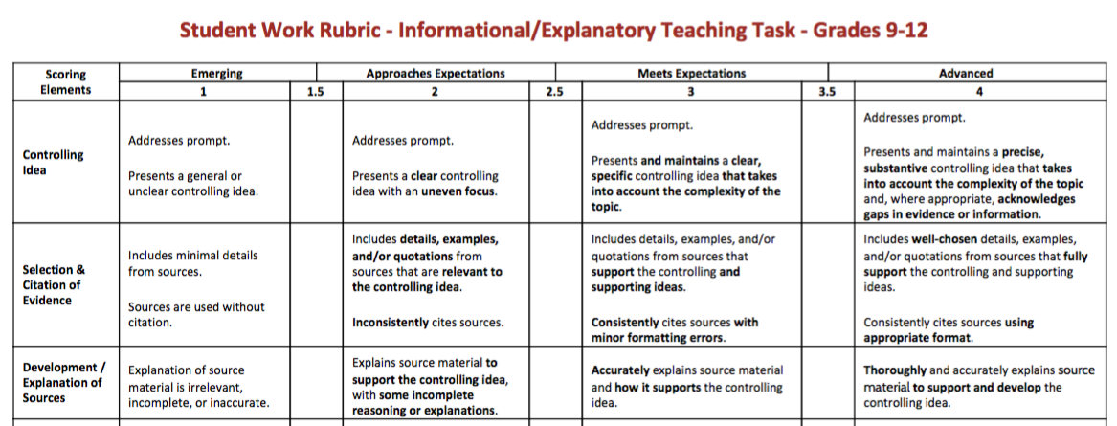
Development/Explanation of Sources

Slide 16
Example 1
“Redshift and Blueshift also help prove the theory of the Big Bang. Redshift and Blueshift are part of Doppler effect, Redshift shows that galaxies that are red are farther away and will continue to move away, Blueshift is the opposite of Redshift. Even though there is no actual proof that all of this happened with the help of Hubble's law and data, scientists have come to the prediction that galaxies are moving away because of the vast amounts of energy left from this mass explosion.”
Mrs. Morel’s Score: 2

Slide 17
Example 2
“According to Nasa “Baryonic matter could still make up the dark matter if it were all tied up in brown dwarfs or in small, dense chunks of heavy elements.” So essentially it was a war between light matter and antimatter. Kind of like the force; there is light force and the dark force.”
Mrs. Morel’s Score: 1

Slide 18
Example 3
So, the expansion of the universe is further proven by the percentage of helium, and if there was less helium, the universe would be expanding slower. But, the amount made matches up with models of how the Big Bang happened and at what speed, so this is a very important aspect of the Big Bang.
Mrs. Morel’s Score: 3

Slide 19
Example 4
“The men were asked to try to help figure out what was causing an annoying hiss in early calls relayed by satellites (“Evidence for the Big Bang Theory”, 00:17). They used a giant antenna for their research and tested it at an empty patch in the sky. Contrary to their prediction, they picked up a faint microwave signal indicating that the theory of the Big Bang had evidence to it. The theory of the Big Bang was being explored in Princeton New Jersey and the studies conducted there suggested that the universe was created with a huge burst of energy. They also theorized that, because there was so much radiation with the start of the universe, that there must be some leftover the the explosion. Penzias and Wilson proved that part of the theory with their discovery of cosmic background radiation.”
Mrs. Morel’s Score: 4

