Slide 1
Atoms and Elements
Geophysical Science

Slide 2
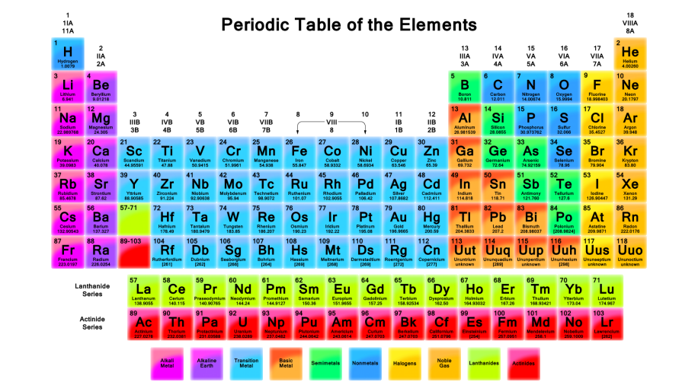
Elements
Elements are pure substances that cannot be broken down
Each element is unique based on its structure
Arranged in the periodic table
It’s formal name is the Periodic Table of ELEMENTS!!

Slide 3
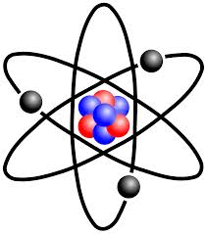
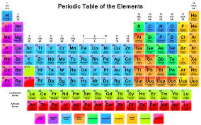
Elements vs Atoms
What the heck is the difference?

Slide 4
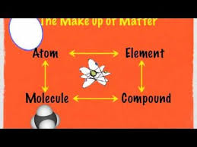
Elements vs Atoms
Elements are TYPES of atoms
Atoms, too, cannot be broken down any smaller
Atoms are considered the building blocks of matter
Matter = anything that has mass and takes up space

Slide 5
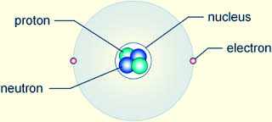
Atom Structure
Atoms are made up of THREE subatomic particles
Protons
Electrons
Neutrons

Slide 6
Atomic Structure
Each of these particles have a particular charge
Protons are Positive
Electrons are Negative
Neutrons are Neutral (no charge)

Slide 7
Atomic Structure
Atoms have a nucleus in the center
Protons and neutrons are found here
Electrons will float around on the outside
“electron cloud”

Slide 8
Bohr Model
Movie!
Bohr said that the electrons live in “shells” around the nucleus.
The first shell holds 2 electrons
The next shells can hold up to 8 electrons
P= 10
N = 10

Slide 9
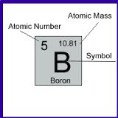
Periodic Table Connection
Number of protons = atomic number

Slide 10
Periodic Table Connections
PROTONS and NEUTRONS contribute to the atomic mass
Measured in atomic mass units (amu’s)
PROTONS + NEUTRONS = ATOMIC MASS

Slide 11
Practice
How many protons does CARBON (C) have?
6
This element has just ONE proton. What element is this?
Hydrogen
Boron has a mass of around 11.
How many protons does it have?
5
How many neutrons?
6

Slide 12
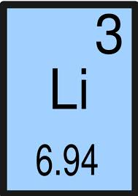
Lithium
Atomic Symbol = Li
Atomic Number = 3
Atomic Mass = 6.94 amu
Mass # = 7
# of Protons = 3
# of Electrons = 3
# of Neutrons = 4

Slide 13
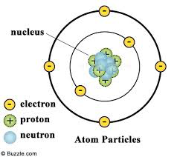
Element Identity
The number of protons DEFINES the element
If you change the number of protons, you change the element
The number of NEUTRONS and ELECTRONS can change

Slide 14
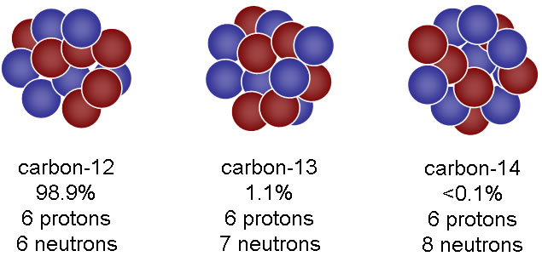
Isotopes
Isotopes = same atom (same PROTONS), but different number of neutrons
All of these atoms are ISOTOPES of carbon

Slide 15
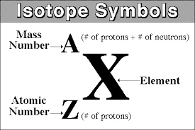
Isotope Symbol
Carbon-12
Carbon-13
Carbon-14

Slide 16
Practice
Write the isotope symbol for each:
Oxygen with atomic mass of 16
Nitrogen with an atomic mass of 15
¹⁵ ₇N
What is the name of this isotope?
Lithium-7

Slide 17
Practice
Remember:
Atomic mass = PROTONS + NEUTRONS
How many neutrons are in carbon-14?
8
What is the atomic mass of boron if it has 5 protons and 6 electrons?
11

Slide 18
Recap
The number of protons are what DEFINES the element
Carbon would not be carbon if it had anything but 6 protons, no more and no less
However, the number of NEUTRONS and ELECTRONS an atom has can vary
When NEUTRONS change, they are called isotopes

Slide 19
Note About Atomic Mass….
The atomic mass in an isotope symbol is a WHOLE number
There are no decimals
The atomic mass found on the periodic table is often a DECIMAL
This is because the mass on the periodic table is actually an AVERAGE of all of the masses of all of the isotopes

Slide 20
Ions
Sometimes atoms can have a charge
You can tell because the atom is written like this:
If there is NO charge, then # electrons = # protons
If there IS a charge, it is called an ion

Slide 21
If there are more ELECTRONS than protons, the atom will be negative
If there are more PROTONS than electrons, the atom will be POSITIVE

Slide 22
Practice
How many protons and electrons does S²⁻ have?
Protons=16
Electrons=18
**You CANNOT change the number of protons S has that you found on the periodic table
How many protons and electrons does Li⁺ have?
Protons: 3
Electrons: 2

Slide 23
REMEMBER: You CANNOT change the number of protons
However, you CAN change….
Electrons, which will form ions
Neutrons, which will form isotopes

Slide 24
Can an atom be both an ION and an ISOTOPE?
YES!!
Element: Potassium
Protons: 19
Neutrons: 20
Electrons: 18

